Slide 1
Recurrent Neural Network (RNN) and Long Short Term Memory (LSTM)
Instructor: Dr. Mohammad Rashedur Rahman

Slide 2
Neural Network needs Memory
Name Entity Recognition
Detecting named entities like name of people, locations, organization, etc. in a sentence.
1
DNN
0.1
people
apple
0
…
0.1
location
0
0.5
organization
0.3
none
0

Slide 3
Neural Network needs Memory
Name Entity Recognition
Detecting named entities like name of people, locations, organization, etc. in a sentence.
target
ORG
target
NONE
y¹
y²
y³
y⁴
y⁵
y⁶
y⁷
DNN
DNN
DNN
DNN
DNN
DNN
DNN
x¹
x²
x³
x⁴
x⁵
x⁶
x⁷
the president of apple eats an apple
DNN needs memory!
Notes:
DNN: input and output are both vector

Slide 4
Recurrent Neural Network (RNN)
The output of hidden layer are stored in the memory.
copy
Memory can be considered as another input.

Slide 5
RNN
y¹
y²
y³
Wº
copy
Wº
copy
Wº
a¹
a²
a³
a¹
a²
W^{h}
W^{h}
W^{i}
W^{i}
W^{i}
x¹
x²
x³
The same network is used again and again.
Output y^{i} depends on x¹, x², …… x^{i}
Notes:
General idea

Slide 6



RNN
How to train?
$${\hat{y}}^{1}$$
target
$${\hat{y}}^{2}$$
target
$${\hat{y}}^{3}$$
target
L¹
L²
L³
y¹
y²
y³
Wº
Wº
Wº
W^{h}
W^{h}
……
W^{i}
W^{i}
W^{i}
x¹
x²
x³
Find the network parameters to minimize the total cost:
Backpropagation through time (BPTT)
Notes:
General idea

Slide 7
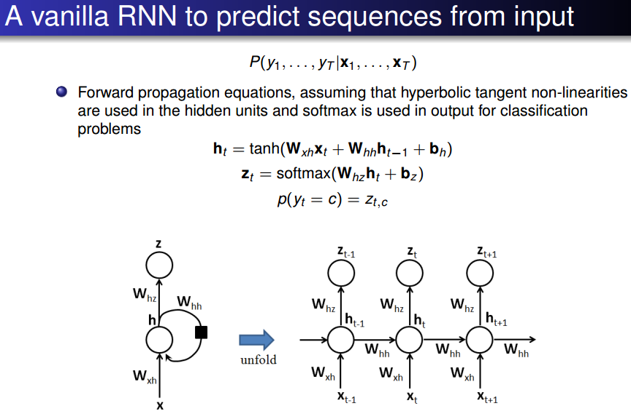
RNN

Slide 8
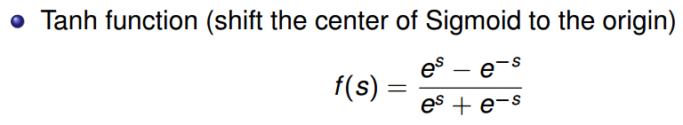
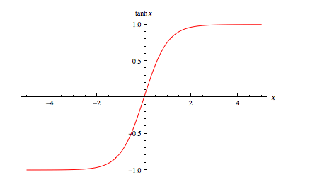
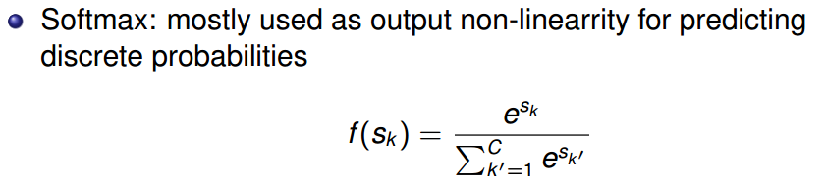
RNN

Slide 9
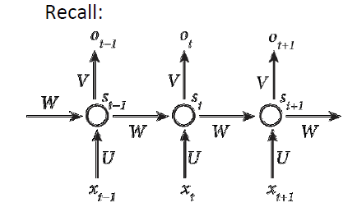
BPTT (Back Propagation Through Time)
Recall
Loss Function

Slide 10
BPTT (cont..)
Goal
• Calculate error gradients w.r.t. U, V and W
• Learn weights using SGD
Just like we sum up errors, we also sum up gradients at each step for one training example

Slide 11
BPTT (cont..)
Where z3 = Vs3 and is X is outer product
What do you think about gradient of E3 w.r.t. W?
Is that complete?
Chain rule needs to be applied again

Slide 12
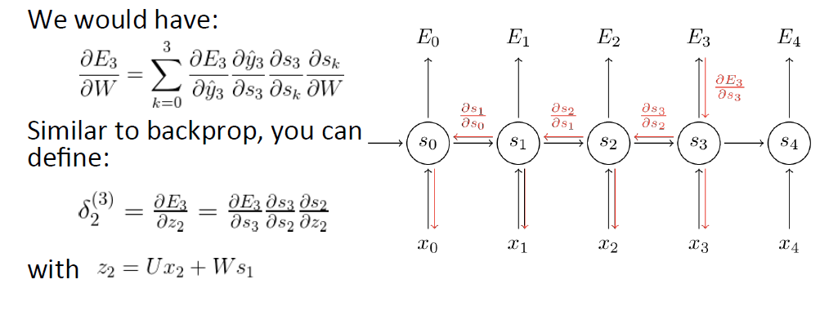
BPTT (cont..)

Slide 13
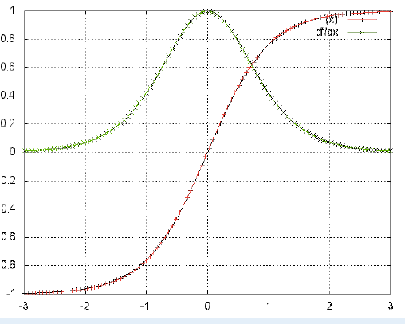
Vanishing Gradient Problem
Sequences (sentences) can be quite long, perhaps 20 words or more - need to back-propagate through many layers!
• Vanishing gradient problem
For sigmoid activations ->gradient is upper-bounded by 1
• What does this tell you?
• Gradients will vanish over time , and long-range dependencies will only worsen learning

Slide 14
Vanishing Gradient Problem (Cont..)
● Derivative of a vector w.r.t a vector is a matrix called jacobian
● 2-norm of the above Jacobian matrix has an upper bound of 1
● tanh maps all values into a range between -1 and 1, and the derivative is bounded by 1
● With multiple matrix multiplications, gradient values shrink exponentially
● Gradient contributions from “far away” steps become zero
● Depending on activation functions and network parameters, gradients could explode instead of vanishing

Slide 15
RNN can be deep also…
y^{t}
y^{t+1}
y^{t+2}
……
……
……
……
……
……
……
……
……
x^{t}
x^{t+1}
x^{t+2}

Slide 16
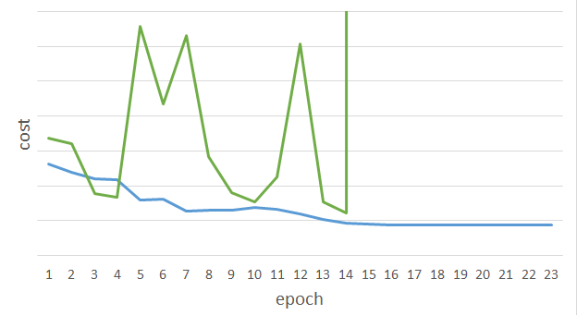
Unfortunately ……
RNN-based network is not always easy to learn
Real experiments on Language modeling
sometimes
Lucky
Notes:
Not because you have bug haha

Slide 17
LSTM Solution
Use memory cell to store information at each time step.
Use “gates” to control the flow of information through the network.
Input gate: protect the current step from irrelevant inputs
Output gate: prevent the current step from passing irrelevant outputs to later steps
Forget gate: limit information passed from one cell to the next

Slide 18
Long Short-term Memory (LSTM)
Other part of the network
Special Neuron:
4 inputs,
1 output
Signal control the output gate
Output Gate
(Other part of the network)
Memory
Cell
Forget Gate
Signal control the forget gate
(Other part of the network)
Signal control the input gate
Input Gate
LSTM
(Other part of the network)
Other part of the network
Notes:
Normal neuron
1 input, 1 output
This one
4 input, 1 output

Slide 19

Transforming RNN to LSTM
$u_{t}=$ $σ(W_{h}h_{t−1}+W_{x}x_{t})$
Start with the same basic structure as our RNN, but call the output vector u1 instead of h1.
h₀
w_{h}
u₁
σ
w_{x}
x₁
Notes:
Start with the same basic structure as our RNN, but call the output vector u1 instead of h1.

Slide 20
Transforming RNN to LSTM
c₀
Now we’re going to add another vector, c, which will be our memory cell. C0 is usually initialized to all 0s, and we’ll see how c is calculated for each time-step in a moment.
Basically, we’re going to want to somehow combine c0 with u1 to get c1. There’s a temptation to apply a set of weights to each and then apply some non-linear function..
h₀
w_{h}
u₁
σ
w_{x}
x₁
Notes:
Now we’re going to add another vector, c, which will be our memory cell. C0 is usually initialized to all 0s, and we’ll see how c is calculated for each time-step in a moment.
Basically, we’re going to want to somehow combine c0 with u1 to get c1. There’s a temptation to apply a set of weights to each and then apply some non-linear function, but that’s what got us into this mess, so let’s not do that.

Slide 21

Transforming RNN to LSTM
c₀
c₁
f₁
$$c_{t}=f_{t}⊙c_{t−1}+i_{t}⊙u_{t}$$
+
h₀
w_{h}
u₁
σ
i₁
w_{x}
x₁
Notes:
Instead, what we’re going to do is pass u1 through our input gate i1, and pass c0 through our forget gate f1, and take their sum. When I say information is “passed through” a gate, I mean take the elementwise product of the input vector and the gate vector.

Slide 22
Transforming RNN to LSTM
c₀
c₁
f₁
$$c_{t}=f_{t}⊙c_{t−1}+i_{t}⊙u_{t}$$
+
Instead, what we’re going to do is pass u1 through our input gate i1, and pass c0 through our forget gate f1, and take their sum. When I say information is “passed through” a gate, I mean take the elementwise product of the input vector and the gate vector
h₀
w_{h}
u₁
σ
i₁
w_{x}
x₁
Notes:
It’s a big deal that c is calculated using a linear function.

Slide 23
Transforming RNN to LSTM
c₀
c₁
f₁
$$c_{t}=f_{t}⊙c_{t−1}+i_{t}⊙u_{t}$$
+
The gate vector will have values from 0 to 1. A gate value of 0 is closed: it doesn’t let information pass through it. A gate value of 1 lets all of the information pass through it.
h₀
w_{h}
u₁
σ
i₁
w_{x}
At this first time step, the gates aren’t doing much, because we initialized c0 and h0 to vectors of zeros.
But at the next time step, our gates give the network the option of treating the input c as a vector of zeros. So if ct is a memory of everything we’ve seen in the network up to time t, we can totally close our gate and use all 0s for ct at the next step – effectively forgetting everything and going back to our starting value for c.
x₁
Notes:
The gate vector will have values from 0 to 1. A gate value of 0 is closed: it doesn’t let information pass through it. A gate value of 1 lets all of the information pass through it.
At this first time step, the gates aren’t doing much, because we initialized c0 and h0 to vectors of zeros. But at the next time step, our gates give the network the option of treating the input c as a vector of zeros. So if ct is a memory of everything we’ve seen in the network up to time t, we can totally close our gate and use all 0s for ct at the next step – effectively forgetting everything and going back to our starting value for c. The gate vector will have values from 0 to 1. A gate value of 0 is closed: it doesn’t let information pass through it. A gate value of 1 lets all of the information pass through it.

Slide 24

Transforming RNN to LSTM
c₀
c₁
f₁
$f_{t}=$ $σ(W_{hf}h_{t−1}+W_{xf}x_{t})$
f₁
+
w_{hf}
σ
h₀
h₀
w_{h}
u₁
σ
w_{xf}
i₁
w_{x}
x₁
x₁
Notes:
So, where do the magic gates come from? Why, we multiply some input vectors by weights and apply the sigmoid function, of course! The forget gate gets one set of weights…

Slide 25

Transforming RNN to LSTM
c₀
c₁
f₁
$i_{t}=$ $σ(W_{hi}h_{t−1}+W_{xi}x_{t})$
+
w_{hi}
σ
h₀
u₁
h₀
w_{h}
i₁
σ
w_{xi}
i₁
w_{x}
x₁
x₁
Notes:
And the input gate gets a different set.

Slide 26
Transforming RNN to LSTM
c₀
c₁
f₁
$$h_{t}=o_{t}⊙\tanh{c_{t}}$$
+
Finally, we apply a non-linearity to our memory cell, c1, and pass that through the output gate to give us h1
tanh
h₀
w_{h}
u₁
h₁
σ
i₁
o₁
w_{x}
x₁
Notes:
Finally, we apply a non-linearity to our memory cell, c1, and pass that through the output gate to give us h1

Slide 27
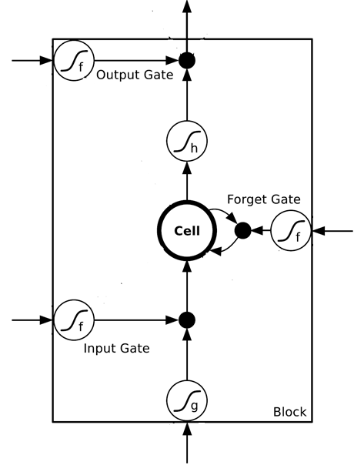
















$$a$$
$$=h\left(c^{′}\right)f\left(z_{o}\right)$$
$$z_{o}$$
multiply
Activation function f is usually a sigmoid function
$$f\left(z_{o}\right)$$
$$h\left(c^{′}\right)$$
Between 0 and 1
Mimic open and close gate
$$c$$
$$f\left(z_{f}\right)$$
c
$$c^{′}$$
$$z_{f}$$
$$cf\left(z_{f}\right)$$
$$c^{′}=g\left(z\right)f\left(z_{i}\right)+cf\left(z_{f}\right)$$
$$f\left(z_{i}\right)$$
$$g\left(z\right)f\left(z_{i}\right)$$
$$z_{i}$$
multiply
$$g\left(z\right)$$
$$z$$

Slide 28




Original Network:
Simply replace the neurons with LSTM
……
……
$$a_{1}$$
$$a_{2}$$
$$z_{1}$$
$$z_{2}$$
x₁
x₂
Input
Notes:
Use a same set of information
Note about the memory

Slide 29


$$a_{1}$$
$$a_{2}$$
+
+
+
+
+
+
+
+
4 times of parameters
x₁
x₂
Input
Notes:
Use a same set of information
Note about the memory

Slide 30









LSTM
Extension: “peephole”
y^{t}
y^{t+1}
c^{t-1}
c^{t}
c^{t+1}
$$×$$
$$＋$$
$$×$$
$$×$$
$$＋$$
$$×$$
$$×$$
$$×$$
z^{f}
z^{i}
z
zº
z^{f}
z^{i}
z
zº
c^{t-1}
h^{t-1}
x^{t}
c^{t}
h^{t}
x^{t+1}
Notes:
Identiy
C is vector

